Slide 1


Kamalesh K B
19-06-2023

Slide 2

Outline
Executive Summary
Introduction
Methodology
Results
Conclusion
Appendix

Slide 3
Executive Summary
Summary of methodologies
Data collection through API & with Web Scraping
Data Wrangling
EDA with SQL
EDA with Visualization
Interactive Map with Folium
Dashboard with Plotly Dash
Predictive Analysis ( Classification )
Summary of all results
EDA Results
Interactive Analysis
Predictive Analysis

Slide 4
Introduction
Project background and context
Space X advertises Falcon 9 rocket launches on its website with a cost of 62 million dollars; other providers cost upward of 165 million dollars each, much of the savings is because Space X can reuse the first stage. Therefore, if we can determine if the first stage will land, we can determine the cost of a launch. This information can be used if an alternate company wants to bid against space X for a rocket launch. This goal of the project is to create a machine learning pipeline to predict if the first stage will land successfully.
Problems you want to find answers
The project task is to predicting if the first stage of the SpaceX Falcon 9 rocket will land successfully.

Slide 5

Section 1

Slide 6
Methodology
Executive Summary
Data collection methodology:
SpaceX Rest API
Web Scraping from Wikipedia
Perform data wrangling
One Hot Encoding data fields for Machine Learning and data cleaning of null values and irrelevant columns
Perform exploratory data analysis (EDA) using visualization and SQL
Perform interactive visual analytics using Folium and Plotly Dash
Perform predictive analysis using classification models
LR, KNN, SVM, DT models have been built and evaluated for the best classifier

Slide 7
Data Collection
The source of datasets are :
Using get request to the SpaceX Rest API
And using .json() function call and turn it into a pandas dataframe using .json_normalize().
In addition Wikipedia of falcon 9 launch records with BeatifulSoup
And extract the launch records as HTML table, parse the table and convert it to a pandas dataframe for future analysis.

Slide 8
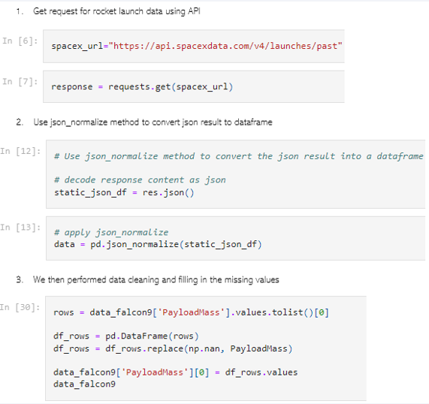
Data Collection – SpaceX API
Data collection with SpaceX REST API calls.
https://github.com/Kamalesh-02/SpaceX-Falcon9-Landing-Prediction/blob/main/1.%20The%20Data%20Collection%20With%20API.ipynb

Slide 9
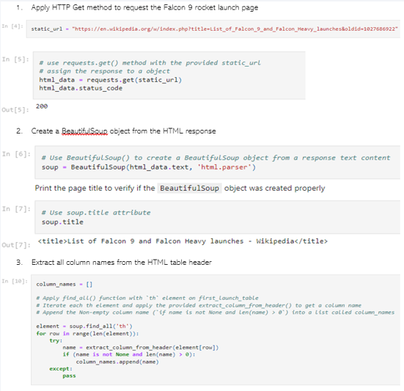
Data Collection - Scraping
We applied web scrapping to webscrap Falcon 9 launch records with BeautifulSoup
We parsed the table and converted it into a pandas dataframe.
https://github.com/Kamalesh-02/SpaceX-Falcon9-Landing-Prediction/blob/main/2.%20The%20Data%20Collection%20With%20Web%20Scraping.ipynb

Slide 10
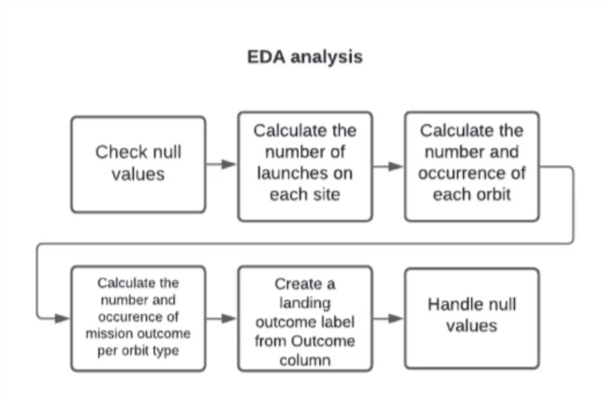
Data Wrangling
https://github.com/Kamalesh-02/SpaceX-Falcon9-Landing-Prediction/blob/main/3.%20Data%20Wrangling.ipynb

Slide 11
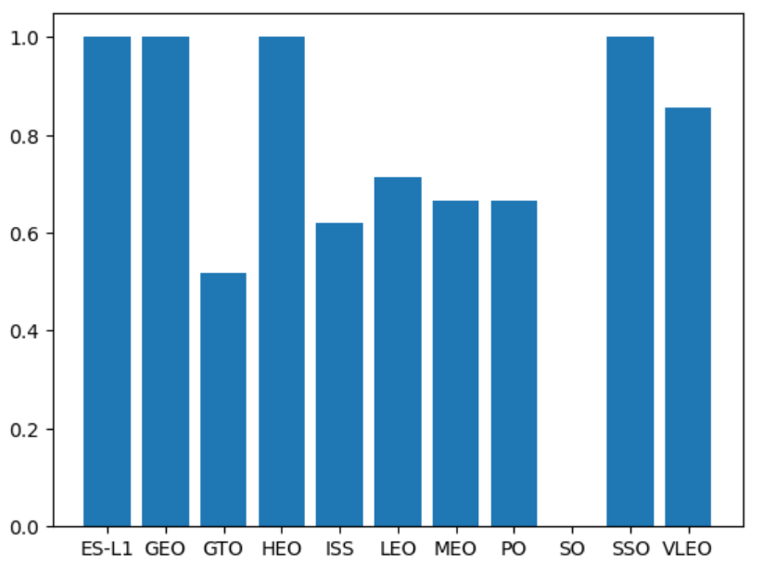
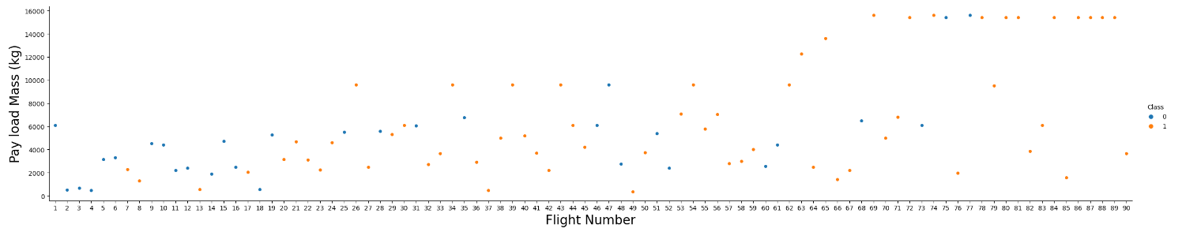
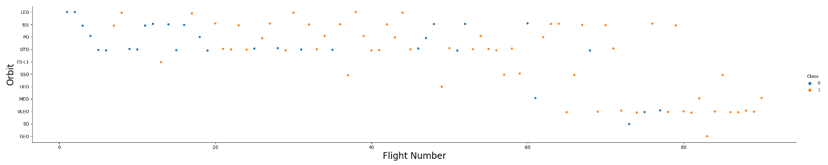
EDA with Data Visualization
We explored the data by visualizing the relationship between flight number and launch Site, payload and launch site, success rate of each orbit type, flight number and orbit type, the launch success yearly trend.
https://github.com/Kamalesh-02/SpaceX-Falcon9-Landing-Prediction/blob/main/5.%20EDA%20with%20Visualization.ipynb

Slide 12
EDA with SQL
SQL queries performed includes:
Display the names of the unique launch sites in the space mission
Display 5 records where launch sites begin with the string 'CCA'
Display the total payload mass carried by boosters launched by NASA (CRS)
Display average payload mass carried by booster version F9 v1.1
List the date when the first succesful landing outcome in ground pad was acheived.
List the names of the boosters which have success in drone ship and have payload mass greater than 4000 but less than 6000
List the total number of successful and failure mission outcomes
List the names of the booster_versions which have carried the maximum payload mass. Use a subquery
List the records which will display the month names, failure landing_outcomes in drone ship ,booster versions, launch_site for the months in year 2015.
Rank the count of successful landing_outcomes between the date 04-06-2010 and 20-03-2017 in descending order.
https://github.com/Kamalesh-02/SpaceX-Falcon9-Landing-Prediction/blob/main/4.%20EDA%20with%20SQL.ipynb

Slide 13
Build an Interactive Map with Folium
We marked all launch sites, and added map objects such as markers, circles, lines to mark the success or failure of launches for each site on the folium map.
We assigned the feature launch outcomes (failure or success) to class 0 and 1.i.e., 0 for failure, and 1 for success.
Using the color-labeled marker clusters, we identified which launch sites have relatively high success rate.
We calculated the distances between a launch site to its proximities. We answered some question for instance:
Are launch sites near railways, highways and coastlines.
Do launch sites keep certain distance away from cities.
https://github.com/Kamalesh-02/SpaceX-Falcon9-Landing-Prediction/blob/main/6.%20Interactive%20Analytics%20with%20Folium.ipynb

Slide 14
Build a Dashboard with Plotly Dash
Summarize what plots/graphs and interactions you have added to a We built an interactive dashboard with Plotly dash
We plotted pie charts showing the total launches by a certain sites
We plotted scatter graph showing the relationship with Outcome and Payload Mass (Kg) for the different booster version.
https://github.com/Kamalesh-02/SpaceX-Falcon9-Landing-Prediction/blob/main/7.%20Interactive%20Dashboard%20with%20Plotly%20Dash.ipynb

Slide 15
Predictive Analysis (Classification)
Loaded the data using numpy and pandas, transformed the data, split our data into training and testing.
We built SVM, KNN & Logistic Regresion machine learning models and tune different hyperparameters using GridSearchCV.
We used accuracy as the metric for our model, improved the model using feature engineering and algorithm tuning.
The SVM, KNN and Logistic Regression model achieved the highest accuracy at 83.3%, while the SVM performs the best in terms of Area under the curve at 0.958.
https://github.com/Kamalesh-02/SpaceX-Falcon9-Landing-Prediction/blob/main/8.%20The%20Machine%20Learning%20Prediction.ipynb

Slide 16
Results
The SVM, KNN and Logistic Regression models are the best in terms of prediction accuracy for this dataset.
Low weighted payloads perform better than the heavier payloads
The success rates for SpaceX launches is directly propositional time in years they will eventually perfect the launches.
KSC LC 39A had the most successful launches from all the sites.
Orbit GEO, HEO, SSO, ES L1 has the best Success Rate.

Slide 17

Section 2

Slide 18
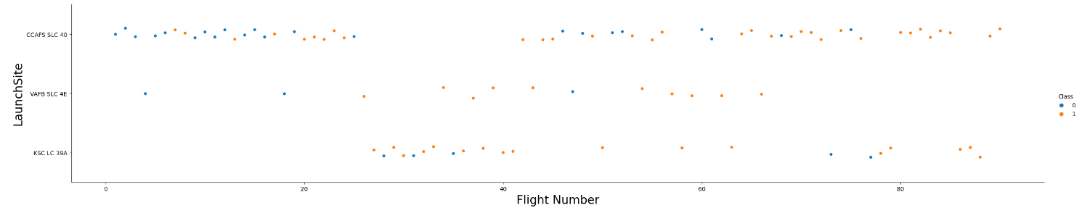
Flight Number vs. Launch Site
Launch from the site of CCAFS SLC 40 are significantly higher than launches from other sites.

Slide 19
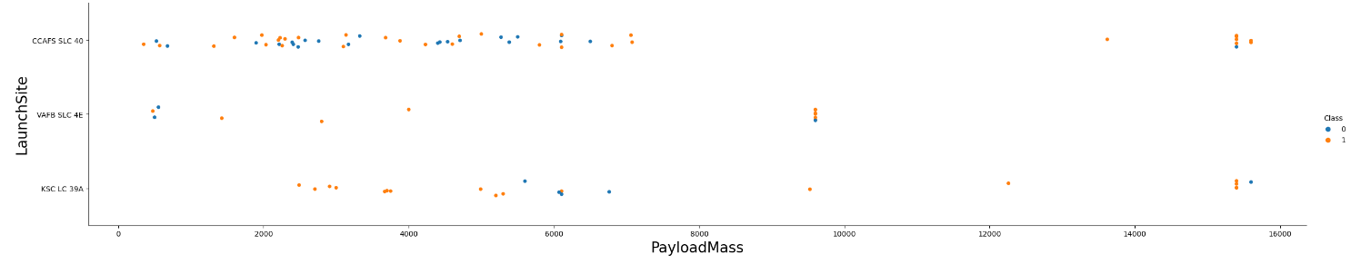
Payload vs. Launch Site
The greater the payload mass for launch site CCAFS SLC 40 the higher the success rate for the rocket.

Slide 20

Success Rate vs. Orbit Type
From the plot, we can see that ES-L1, GEO, HEO, SSO, VLEO had the most success rate.

Slide 21
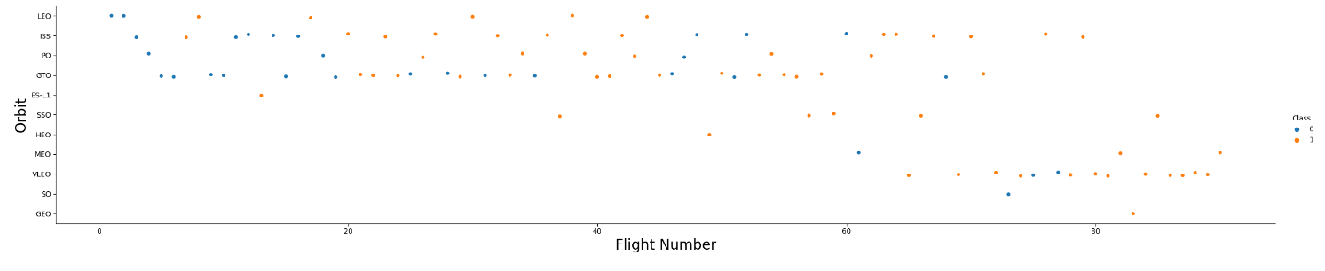
Flight Number vs. Orbit Type
A trend can be observed of shifting to VLEO launches in recent years
We observe that in the LEO orbit, success is related to the number of flights whereas in the GTO orbit, there is no relationship between flight number and the orbit.

Slide 22
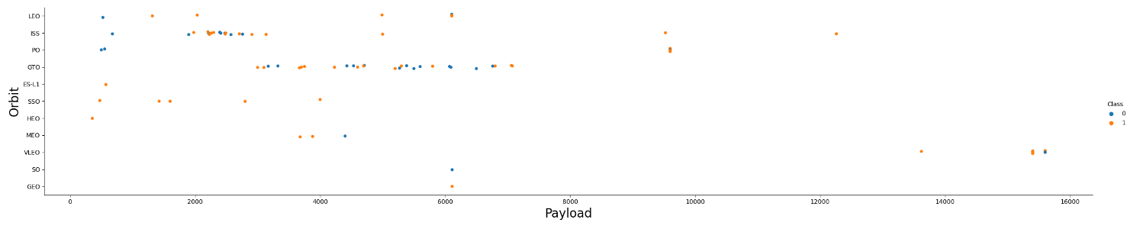
Payload vs. Orbit Type
We can observe that with heavy payloads, the successful landing are more for PO, LEO and ISS orbits.

Slide 23
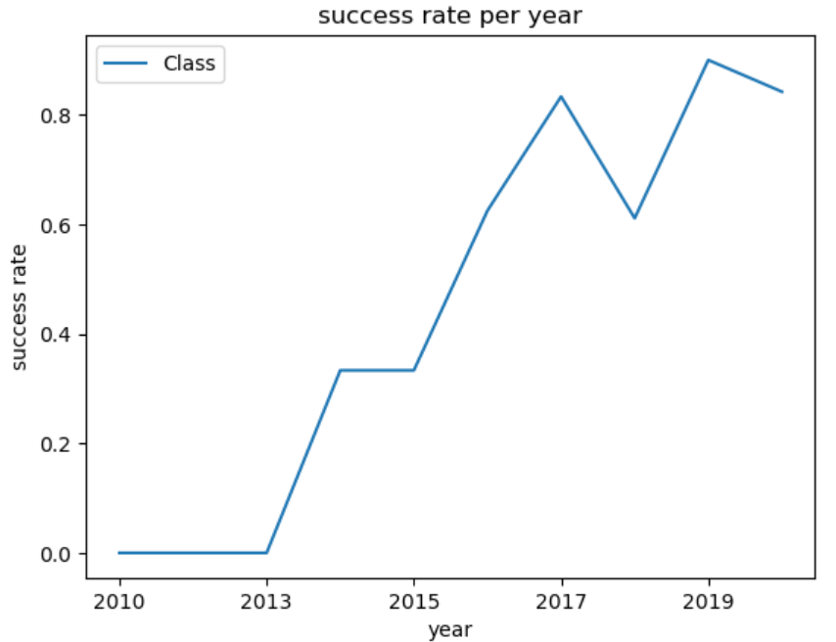
Launch Success Yearly Trend
From the plot, we can observe that success rate since 2013 kept on increasing till 2020. Due to potentially advance in technology.

Slide 24
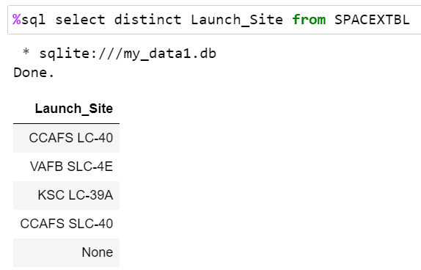
All Launch Site Names

Slide 25
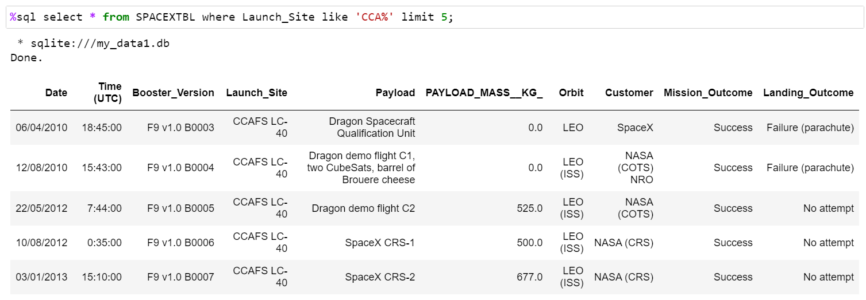
Launch Site Names Begin with 'CCA'

Slide 26
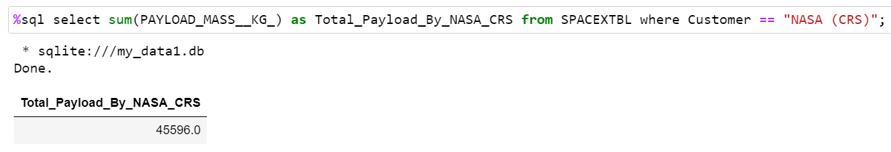
Total Payload Mass

Slide 27
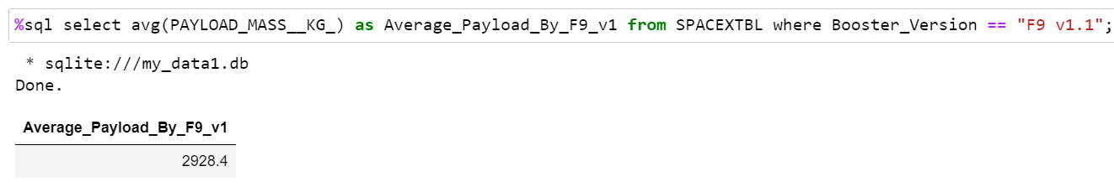
Average Payload Mass by F9 v1.1

Slide 28
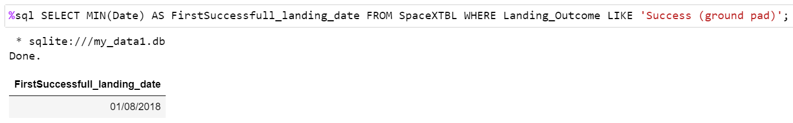
First Successful Ground Landing Date

Slide 29
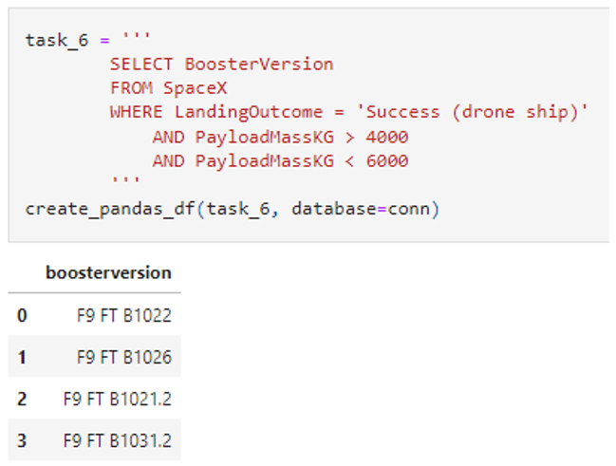
Successful Drone Ship Landing with Payload between 4000 and 6000

Slide 30
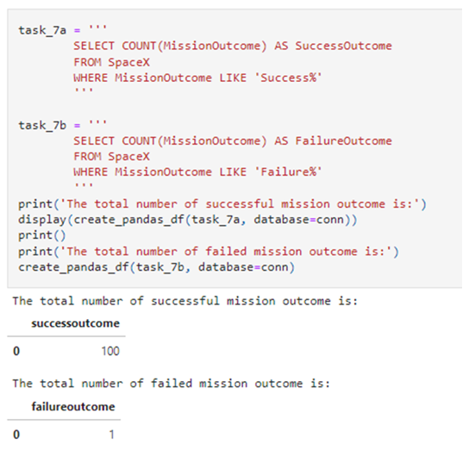
Total Number of Successful and Failure Mission Outcomes

Slide 31
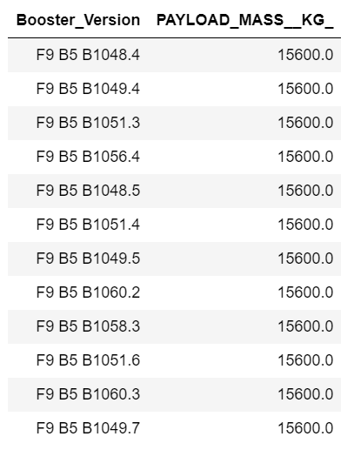
Boosters Carried Maximum Payload
%sql select Booster_Version,PAYLOAD_MASS__KG_ from SPACEXTBL where PAYLOAD_MASS__KG_ == (select Max(PAYLOAD_MASS__KG_) from SPACEXTBL);

Slide 32
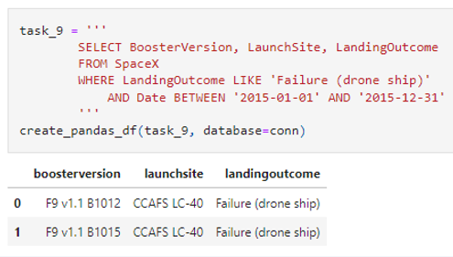
2015 Launch Records

Slide 33
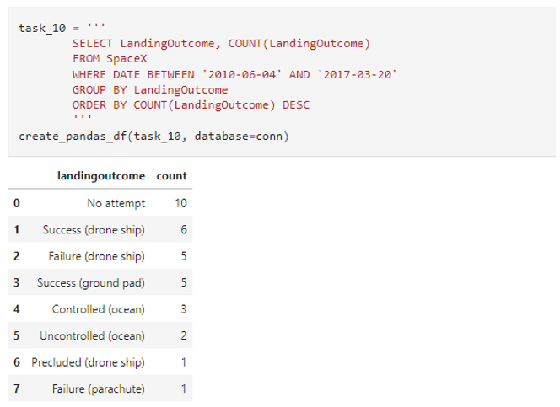
Rank Landing Outcomes Between 2010-06-04 and 2017-03-20

Slide 34

Section 3

Slide 35

All launch sites global map markers

Slide 36

Markers showing launch sites with color labels

Slide 37

Launch Site distance to landmarks

Slide 38

Section 4

Slide 39
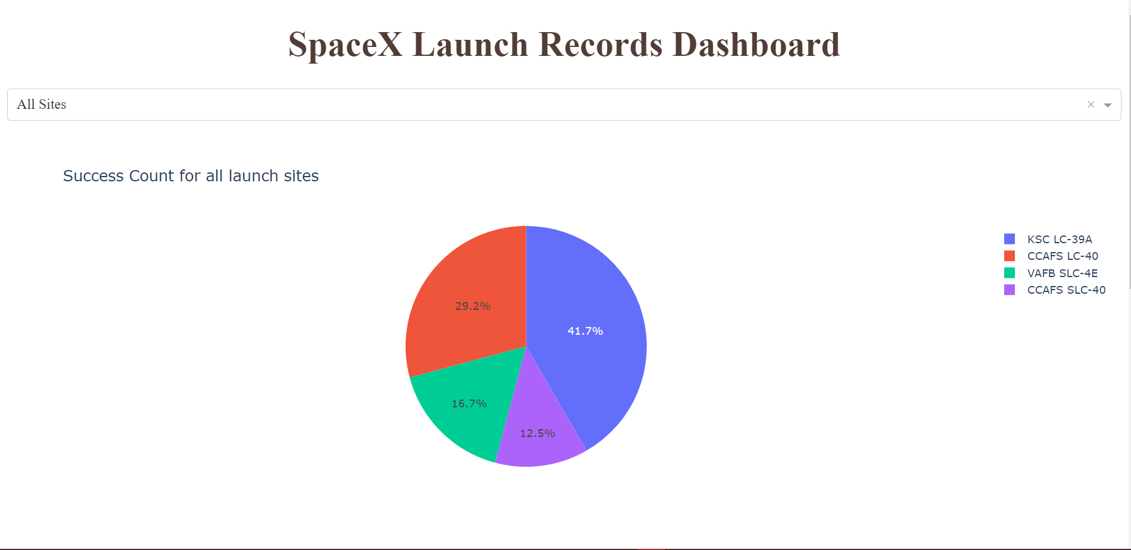
Pie chart to show the total successful launches count for all sites.

Slide 40
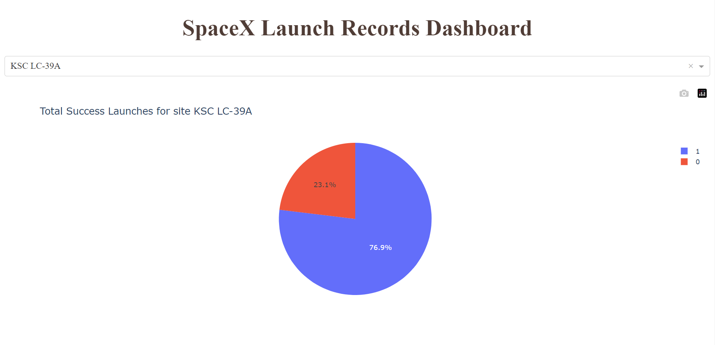
Pie chart show the launch site with highest launch success ratio

Slide 41
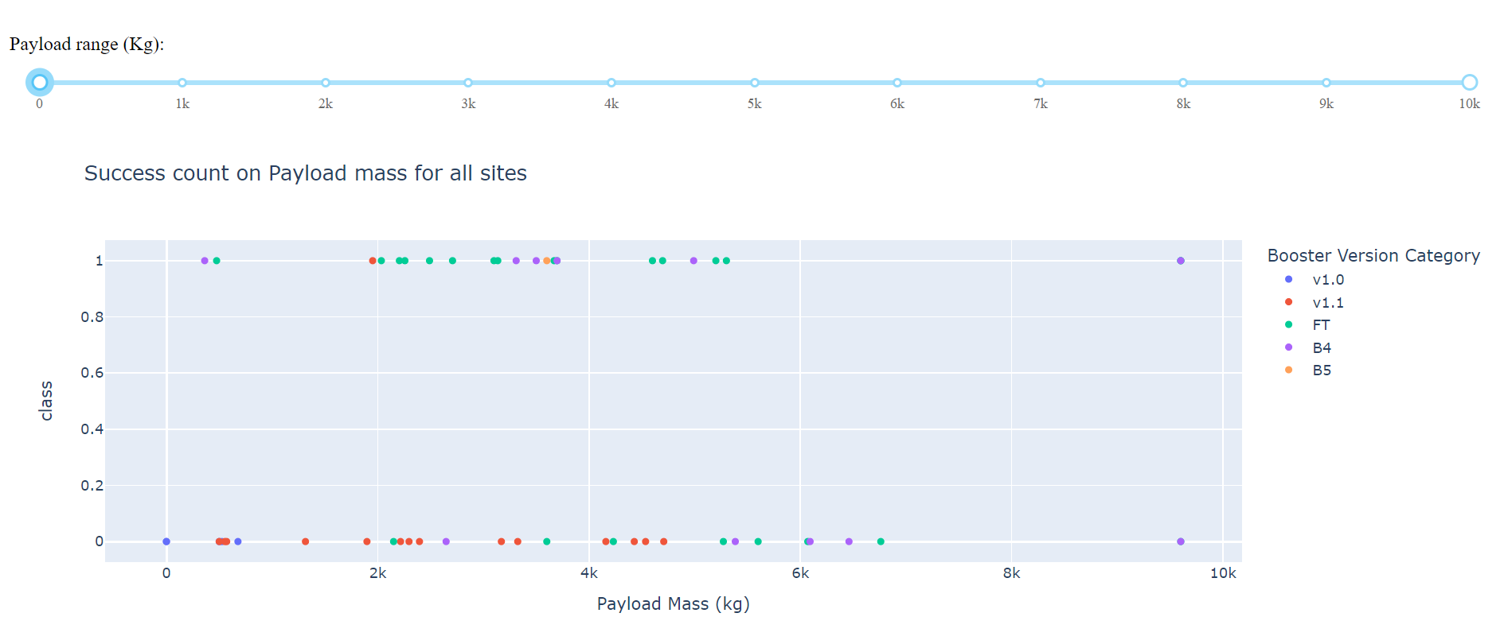
Payload vs. Launch Outcome scatter plot for all sites

Slide 42

Section 5

Slide 43
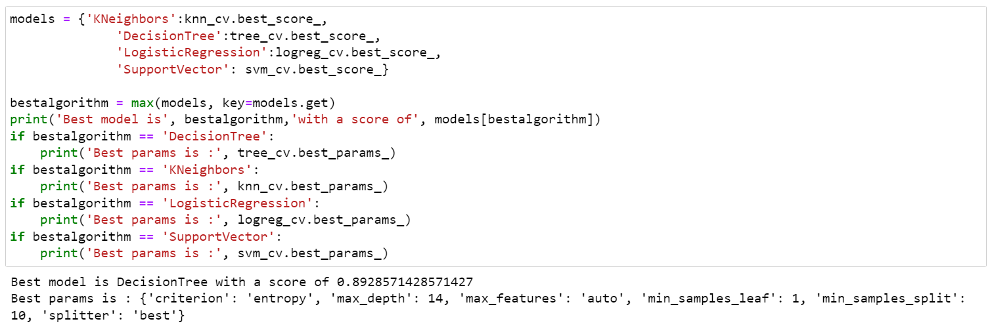
Classification Accuracy
The decision tree classifier is the model with the highest classification accuracy.

Slide 44

Confusion Matrix
The confusion matrix for the decision tree classifier shows that the classifier can distinguish between the different classes. The major problem is the false positives .i.e., unsuccessful landing marked as successful landing by the classifier.

Slide 45
Conclusions
The larger the flight amount at a launch site, the greater the success rate at a launch site.
Low weighted payloads perform better than the Heavier payloads.
KSC LC 39A had the most successful launches from all the sites.
Orbit GEO, HEO, SSO, ES L1 has the best success rate.
The Decision tree classifier is the best machine learning algorithm for this task.

Slide 46


